Slide 1
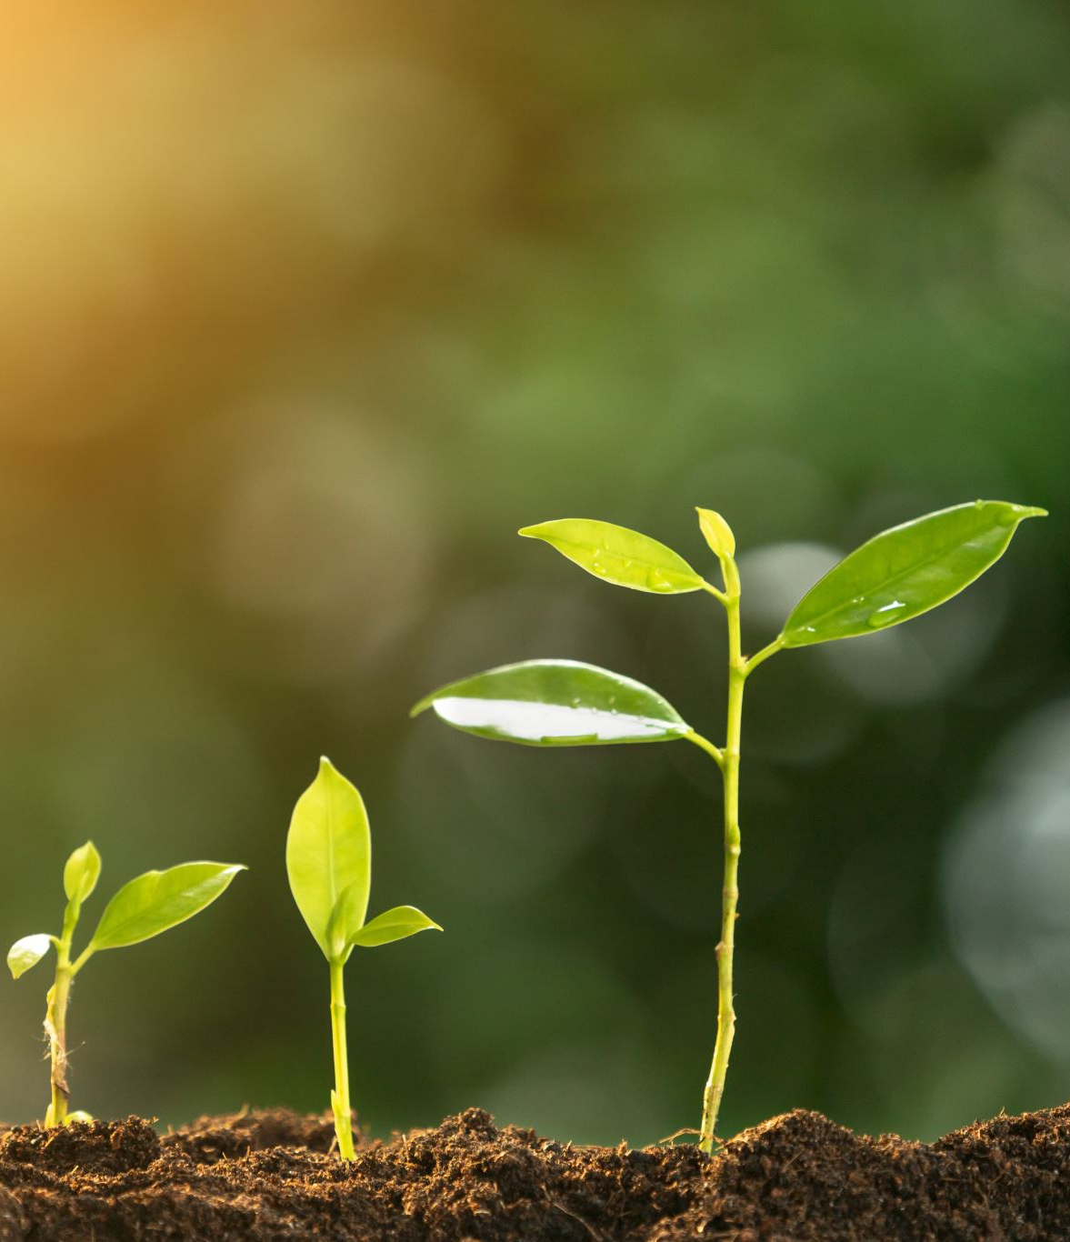
Project GROW
Predictive self-sustaining irrigation system

Slide 2
TEAM MEMBERS:
Preity M
Roll No: 108118074
Dept: ECE
S Rohit
Roll No: 111118103
Dept: MECH
Vaisnav A
Roll No: 108118105
Dept: ECE
Vaibhav A
Roll No: 110118094
Dept: ICE

Slide 3
Introduction:
One of the major scope of IoT is

Slide 4
Motivation for choosing this project:

Slide 5
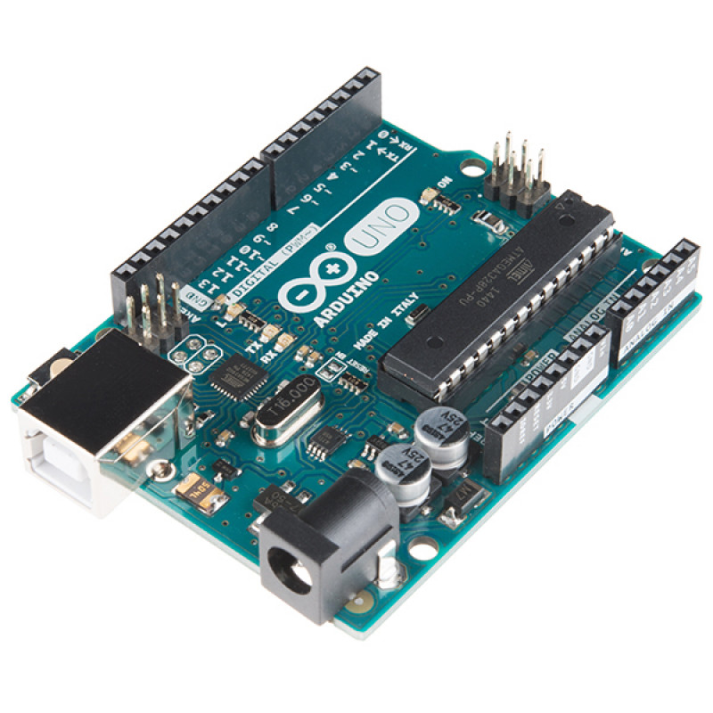
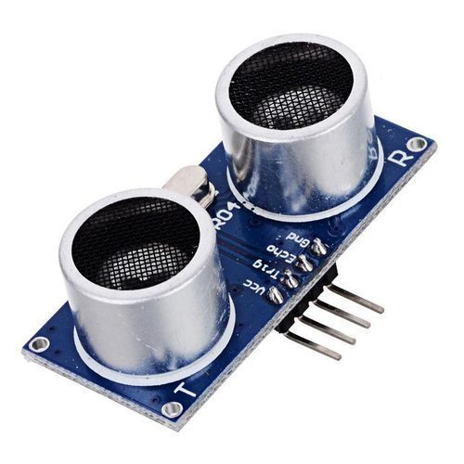
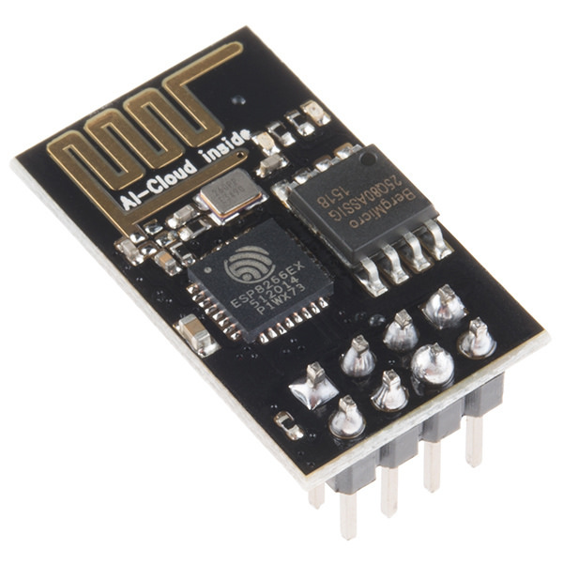
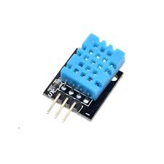
Components Required:
Arduino UNO
Ultrasonic Sensor
ESP-8266
ESP-8266

Slide 6
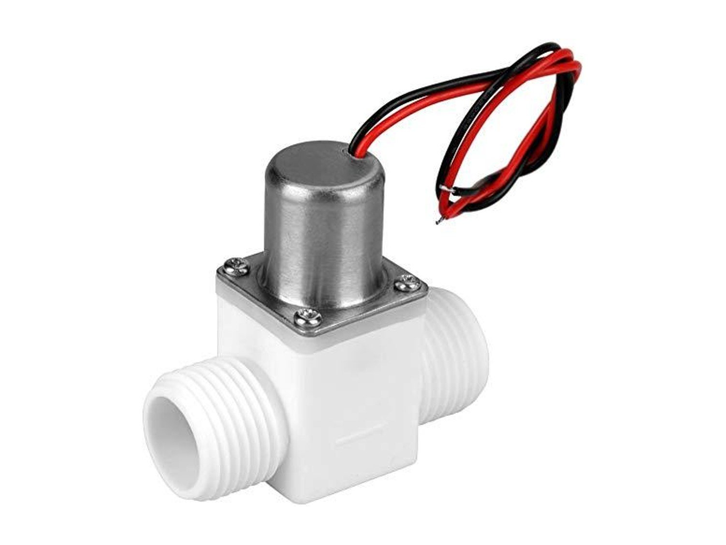
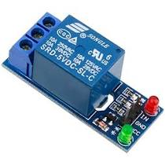
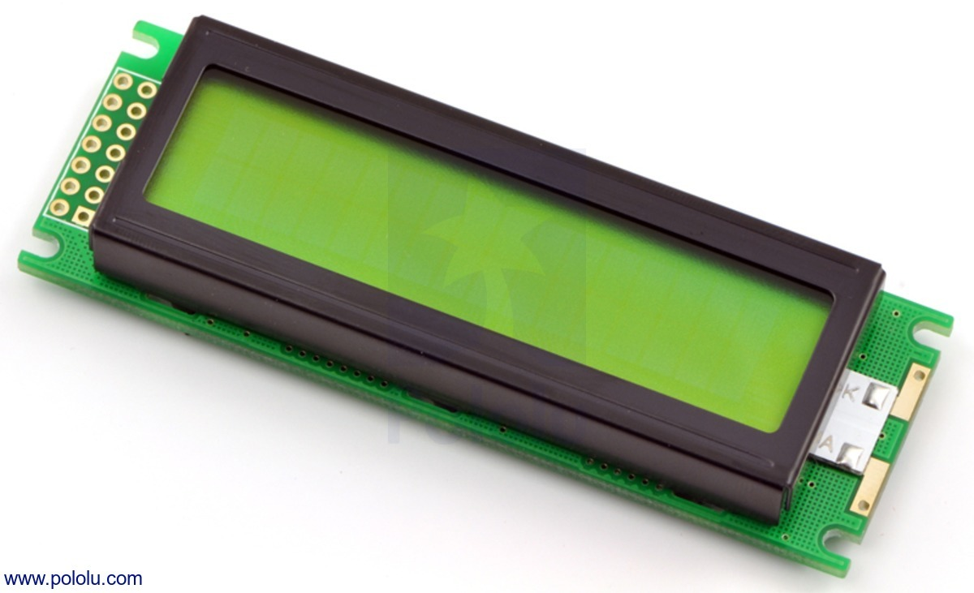
Components Required:
Solenoid Valve
Relay Module
16 x 2 LCD Display

Slide 7
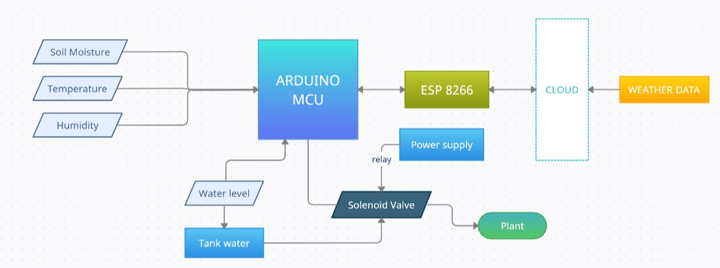
Proposed Block Diagram:

Slide 8
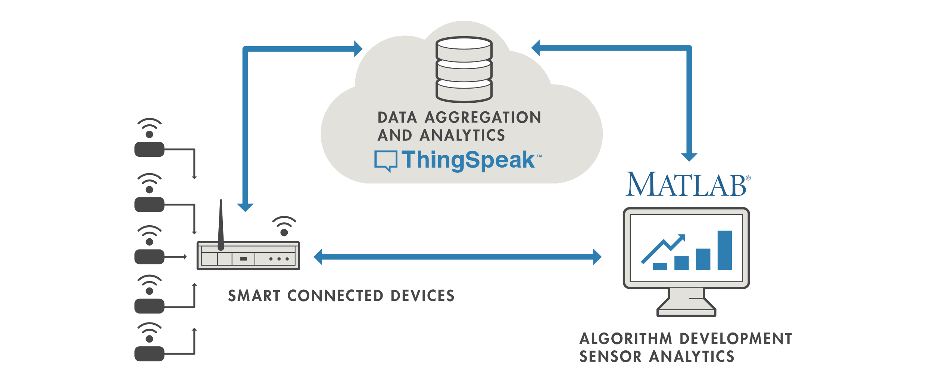
Weather predictive irrigation:
What is the idea?
Forecasting the weather and irrigating the farms accordingly.
Benefits of this implementation:
Judicious use of ground water.
Human intervention will be minimized further.

Slide 9
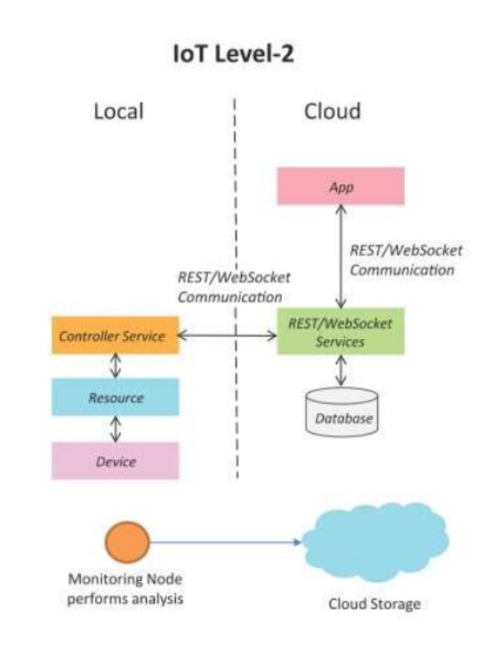
Level of IoT implemented:
The smart irrigation system is an implementation of a LEVEL 2 IoT system.
Here the primary analysis is not computationally intensive and therefore it can be done locally itself.
Since the data is being continuously monitored, the data that is received is quite big and therefore we can opt for cloud based service to stores the data for further analysis.
Here, continuous monitoring and actuators are used in the implementation of the system.

Slide 10
Mobile App(Optional):
We’ll be creating a mobile app for the real time monitoring of the sensed input.
Communication will occur between the application created and thingspeak(MATLAB) via the Thingspeak API.
The user will be able to get weather forecast in the app, along with moisture levels of soil, and the desired water level.
Also the user will get a notification if rains are predicted the next day.
Also the user will get a notification from the app to irrigate/water the plant if the level of water is lesser than the desired levels.

Slide 11
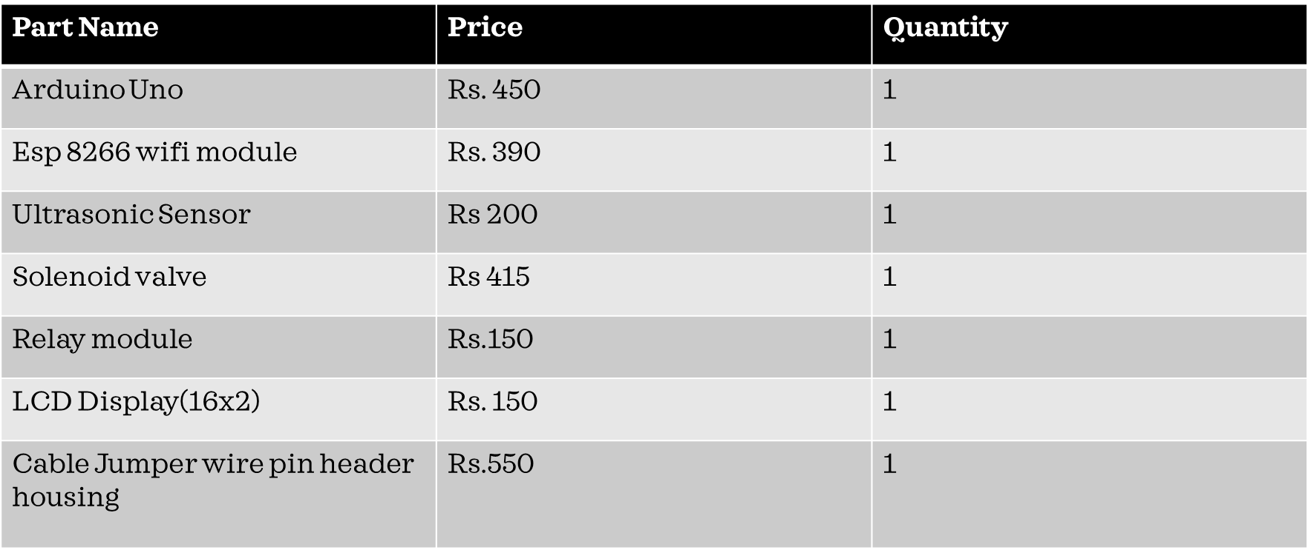
Bill of Materials:

Slide 12
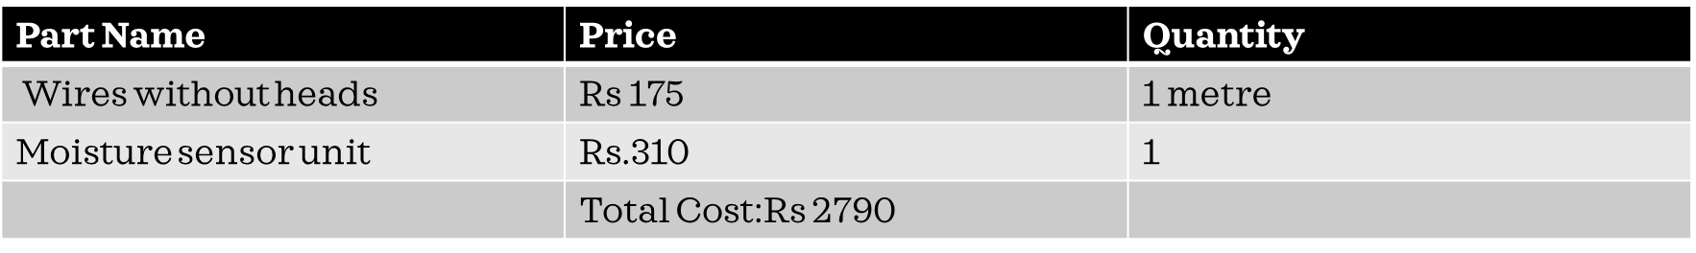
Bill of Materials

Slide 13
Timeline:
March week 4
Procurement of components and materials required for the project .
April week 1-2
Designing the circuitry, integrating the circuits and getting the model ready.
April week 3
Interfacing hardware model with the IoT platform (ThingSpeak) .
April week 4
Analysis of data in the cloud and minimal data processing.
May week 1
Testing and modifications of the integrated model.

Slide 14
Scope of Improvement:
The chemical composition of soil can be analysed and the fertility of soil can be monitored remotely.
Specific data of plants can be studied and the irrigation of the crops can be done in a more judicious way.
Machine learning and deep learning techniques can be employed to improve the accuracy of the model.
A similar model can be developed for the usage of fertilizers as well.

Slide 15
Conclusion:

